Slide 1
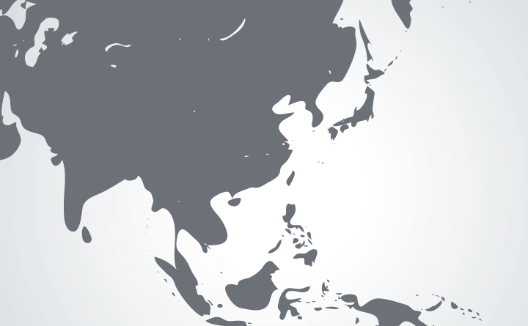
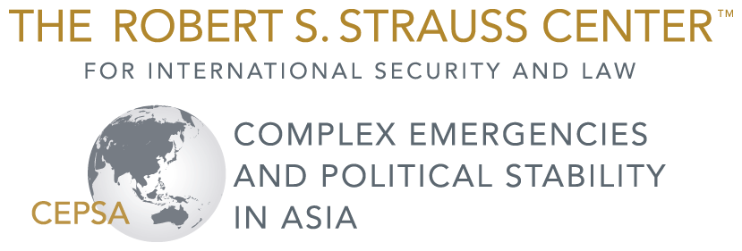
Widening the Scope to Asia: Climate Change and Security
Dr. Joshua W. Busby and Nisha Krishnan
International Studies Association Annual Convention,
New Orleans, Louisiana
February 19, 2015

Slide 2
Outline
Motivation
Background Literature
Preliminary Findings
Future Research

Slide 3
Motivation
Asia has gotten insufficient attention in climate and security issues
Population concentrations and patterns in Asia (esp. in coastal areas) indicate high exposure levels to climate change impacts
Disaster impacts and incidence mismatched with funding allocations (e.g., from ODA)

Slide 4
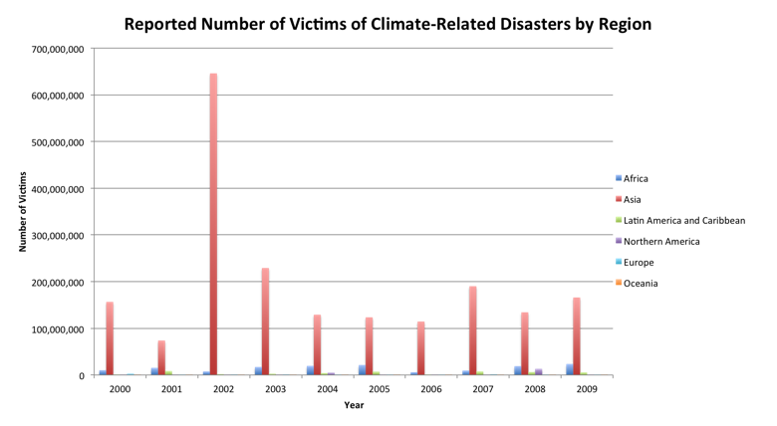
80%+ of disaster victims in Asia
3/4 of USAID disaster assistance (including complex emergencies) to Africa

Slide 5
Background Literature
Skewed towards Africa and conflict: perhaps due to knowledge of existing and expected vulnerabilities and lack of capacity.
Hsiang et al. (2013): meta-analysis on climate and security
  of 60 studies reviewed, only 8 focused on Asia exclusively
Gap apparent in scholarship re: Asia: overdue given exposure to disasters and climate impacts

Slide 6
Research Question
Where are the climate security vulnerabilities located in Asia?
  Where are large numbers of people at risk of death from climate hazard exposure?
  Hazard exposure ≠ disasters

Slide 7
Other Studies of Vulnerability
Wheeler (2011) models the probability of extreme weather impact; finds that China (1), India, (3), Philippines (7), Bangladesh (8), Sri Lanka (9), Vietnam (11), Hong Kong (13), and Thailand (17) are all among the top 20 at risk from extreme events.
Brenkert and Malone (2005): state-level vulnerability in India as part of their Vulnerability-Resilience Indicator Model (VRIM). The VRIM includes seventeen indicators but does not capture exposure.

Slide 8
Assessing Subnational Vulnerability
Identify historical incidence of climate-related disasters, using EM-DAT (CRED)
  records type of disaster, location, start/end dates, affected, killed at admin 1 level
  for 11 countries across South & South-East Asia
    six countries in South Asia (Bangladesh, Bhutan, India, Nepal, Pakistan, and Sri Lanka)
    five countries in Southeast Asia (Cambodia, Laos, Myanmar, Thailand, and Vietnam)
Notes:
included droughts, floods, storms, wet landslides, wildfires, and extreme temperatures.

Slide 9
Preliminary Findings

Slide 10
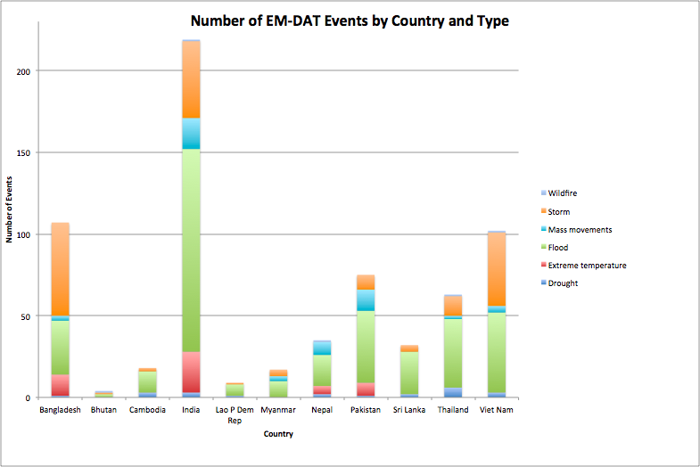

Slide 12
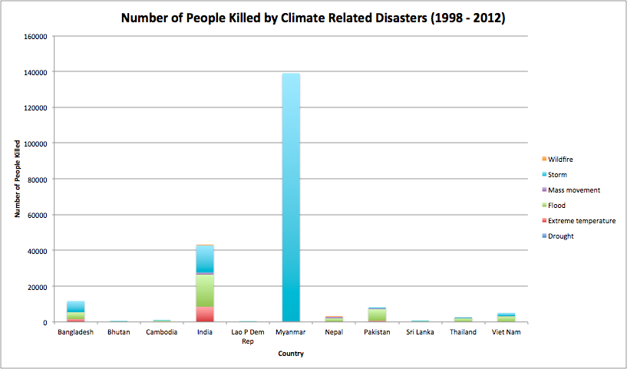

Slide 14
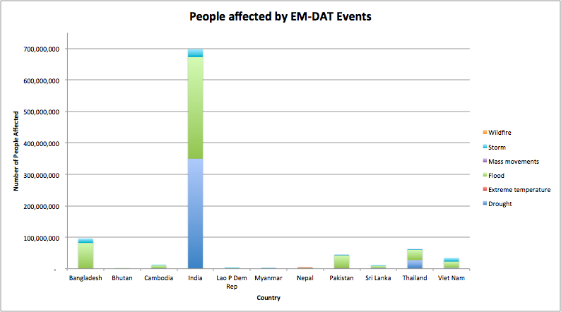

Slide 15
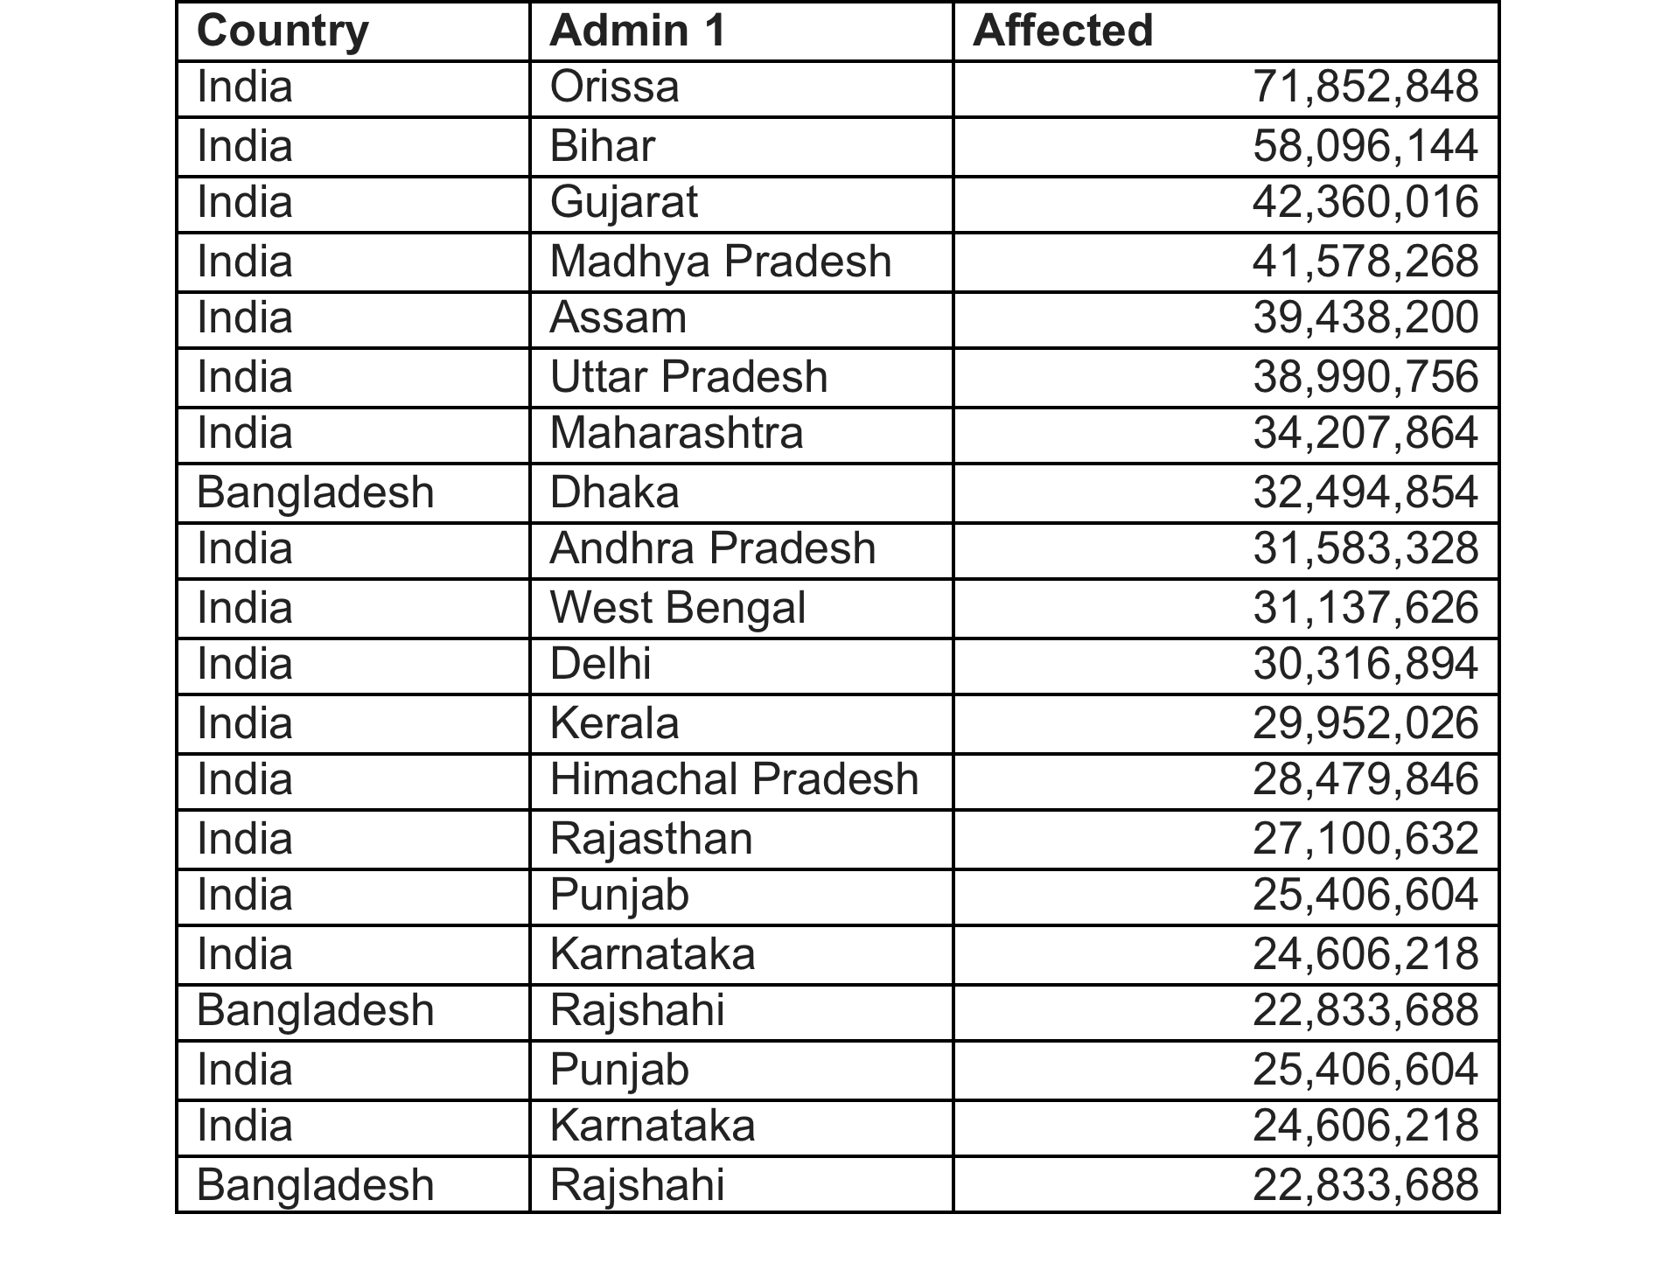
Top 20 Administrative Units by Number of People Affected 1998-2012
Notes:
India and Bangladesh

Slide 17
Brenkert/Malone Findings
Goa, West Bengal, Kerala, Tamil Nadu, Orissa, Gujarat

Slide 18
Future Research
Validate these findings
Develop Asia composite index of subnational climate security vulnerability
  Based on CCAPS model of physical exposure, population density, household and community resilience, and governance
  International Security, Climatic Change, and Political Geography

Slide 19
THANK YOU
THE UNIVERSITY OF TEXAS AT AUSTIN
2315 RED RIVER STREET
AUSTIN, TEXAS 78712
PHONE: 512-471-6267
INFO@STRAUSSCENTER.ORG
STRAUSSCENTER.ORG/CEPSA
This material is based upon work supported by, or in part by, the U.S. Army Research Laboratory and the U. S. Army Research Office via the U.S. Department of Defense’s Minerva Initiative under grant number W911NF-14-1-0528.

